Slide 2
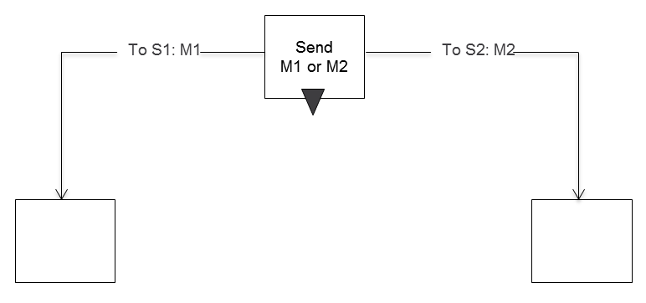
Send

Slide 3
Send Timeout

Slide 4
Receive

Slide 5
Receive Timer

Slide 6
Receive-Break

Slide 7
Symbols Behavior

Slide 8
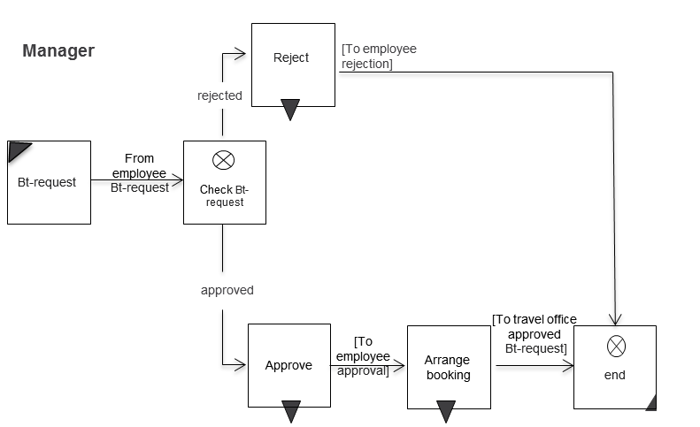
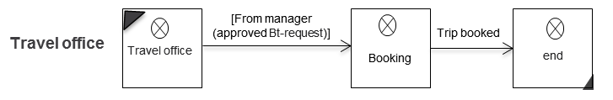
Beispiel

Slide 9
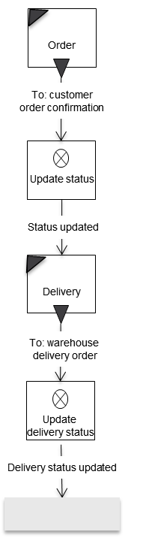
Macro

Slide 10
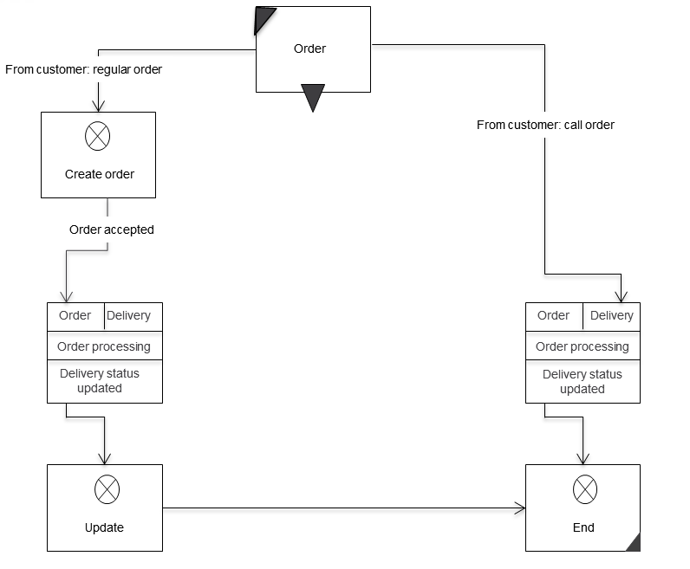
Macro Usage

Slide 11
Exception Handling

Slide 12
SID with Exception

Slide 13
Exception

Slide 14
Extension

Slide 15
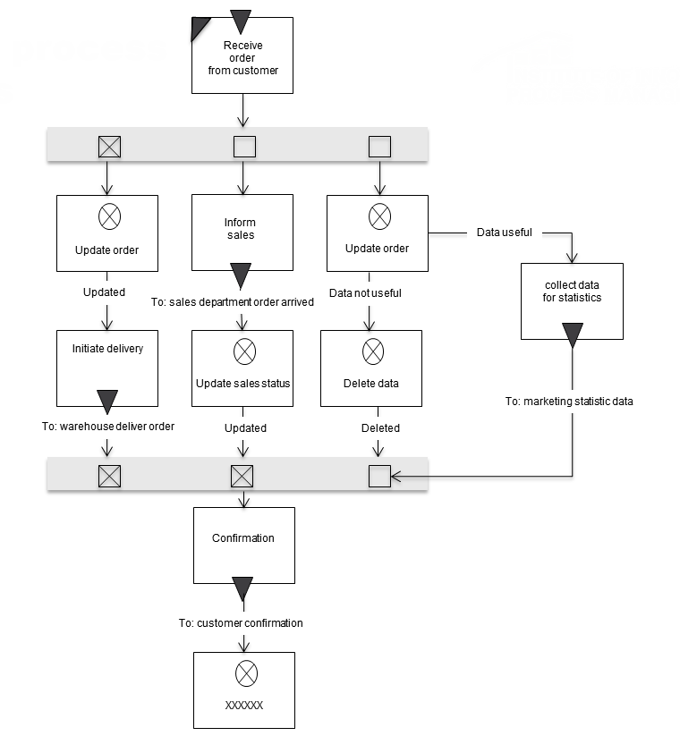
ALternative

Slide 16
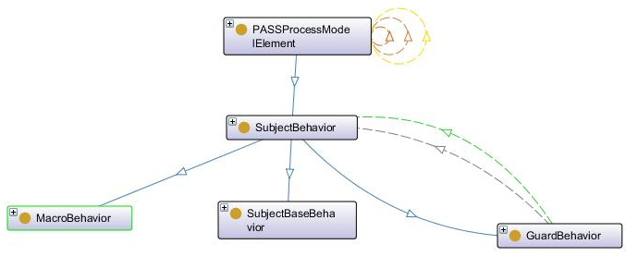
Subject Behavior
085
206
087
088
086

Slide 17
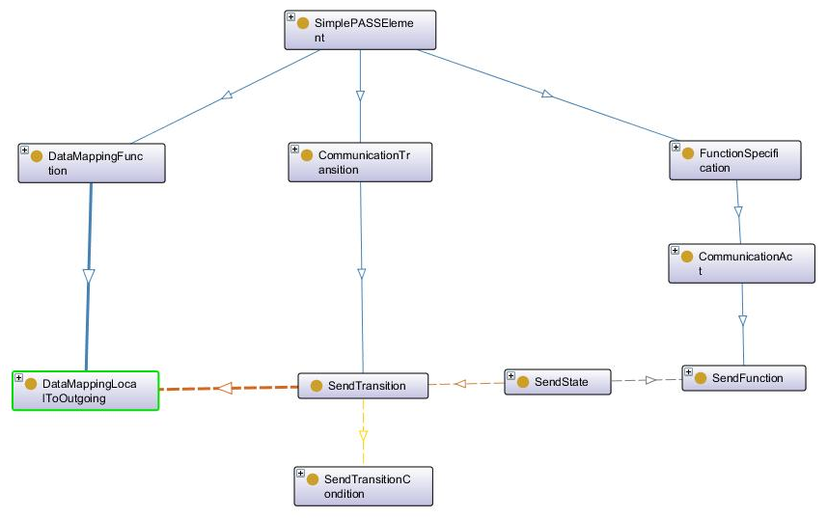
Send Action
093
090
101
095
092
099
100
211
224
214
231

Slide 18
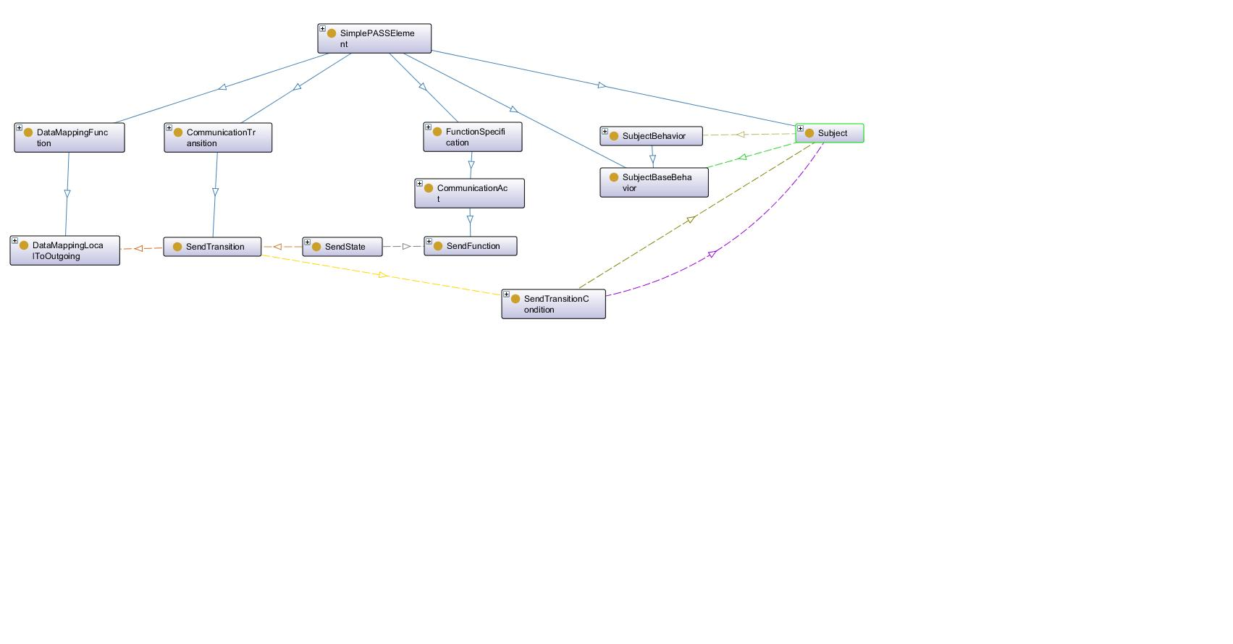
Action Send SUbject

Slide 19
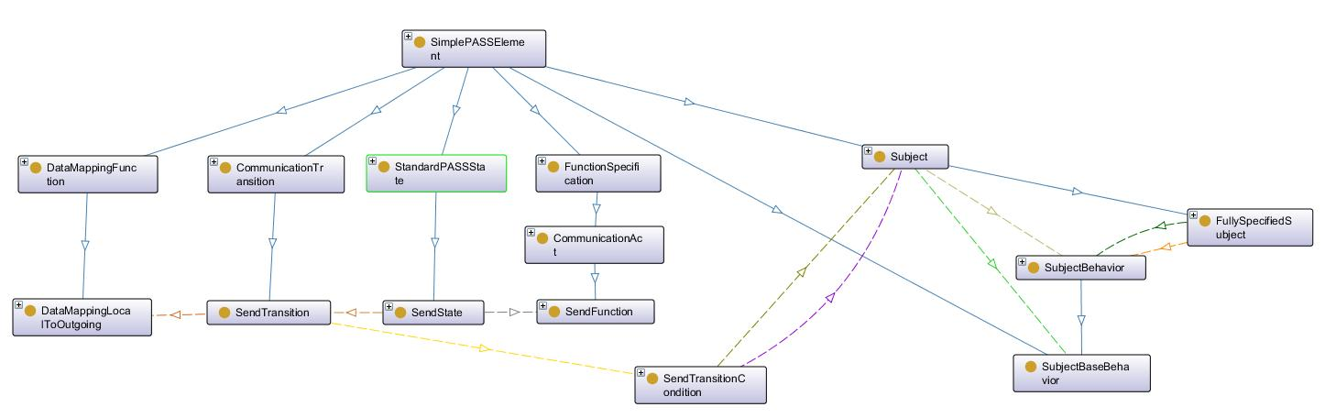

Slide 20
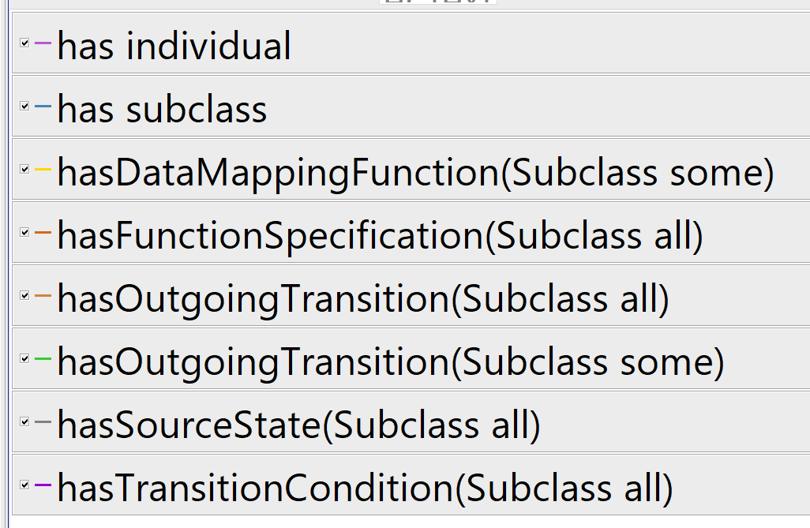
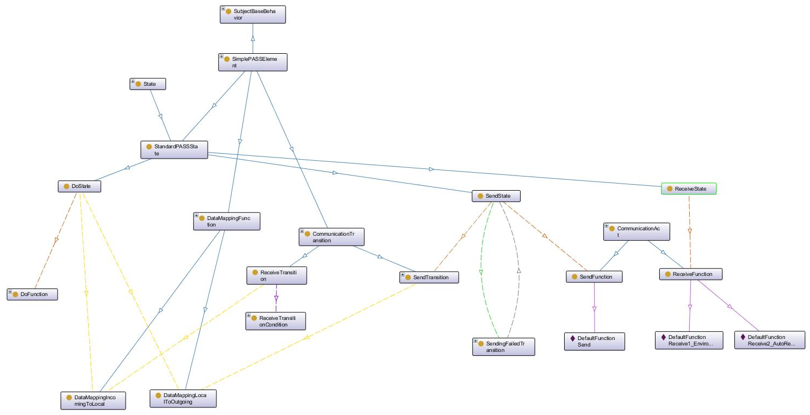
SubjectBaseBehavior
101
101
101
101
101
101
101
101
101
101
101
101
101
101
101
101
101
101
101
101
101
101
101
101
101
101
101

Slide 21
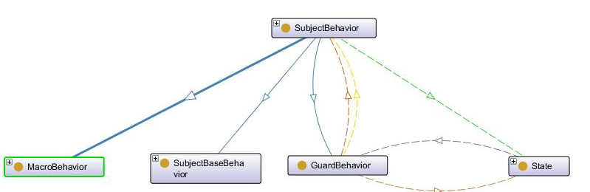
Behavior-Guard
101
101
101
101
101
101
101
101
101
101
101
101
101
101
101
101

